Slide 1
Data Science

Slide 2
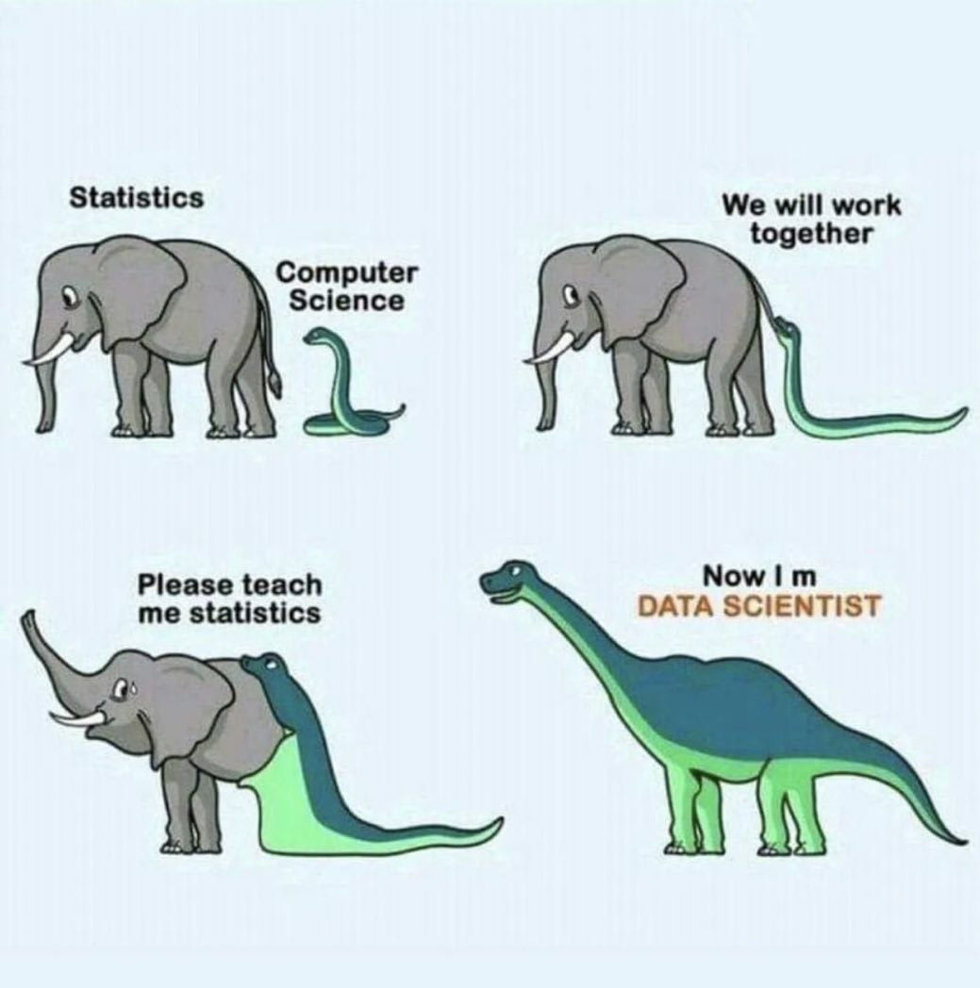

Slide 3
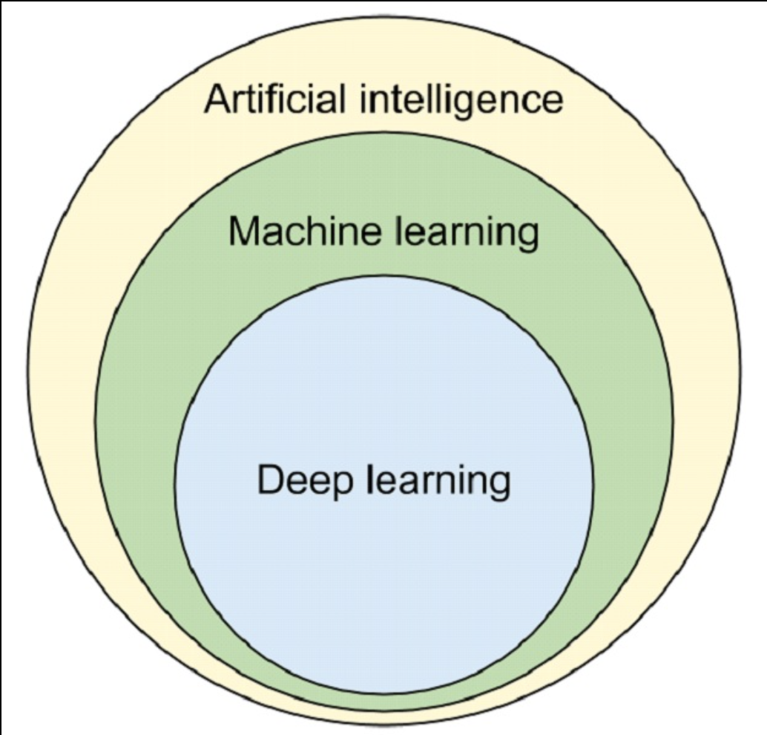
Data Science
Data science is an interdisciplinary field that uses scientific methods, processes, algorithms and systems to extract knowledge and insights from noisy, structured and unstructured data. Data science is related to data mining, machine learning and big data.
Machine learning – one layer. Regression, Decision tree, Random Forest, KNN, Dimensionality reduction (PCA, tSNE)
Deep learning – more than one layer

Slide 4
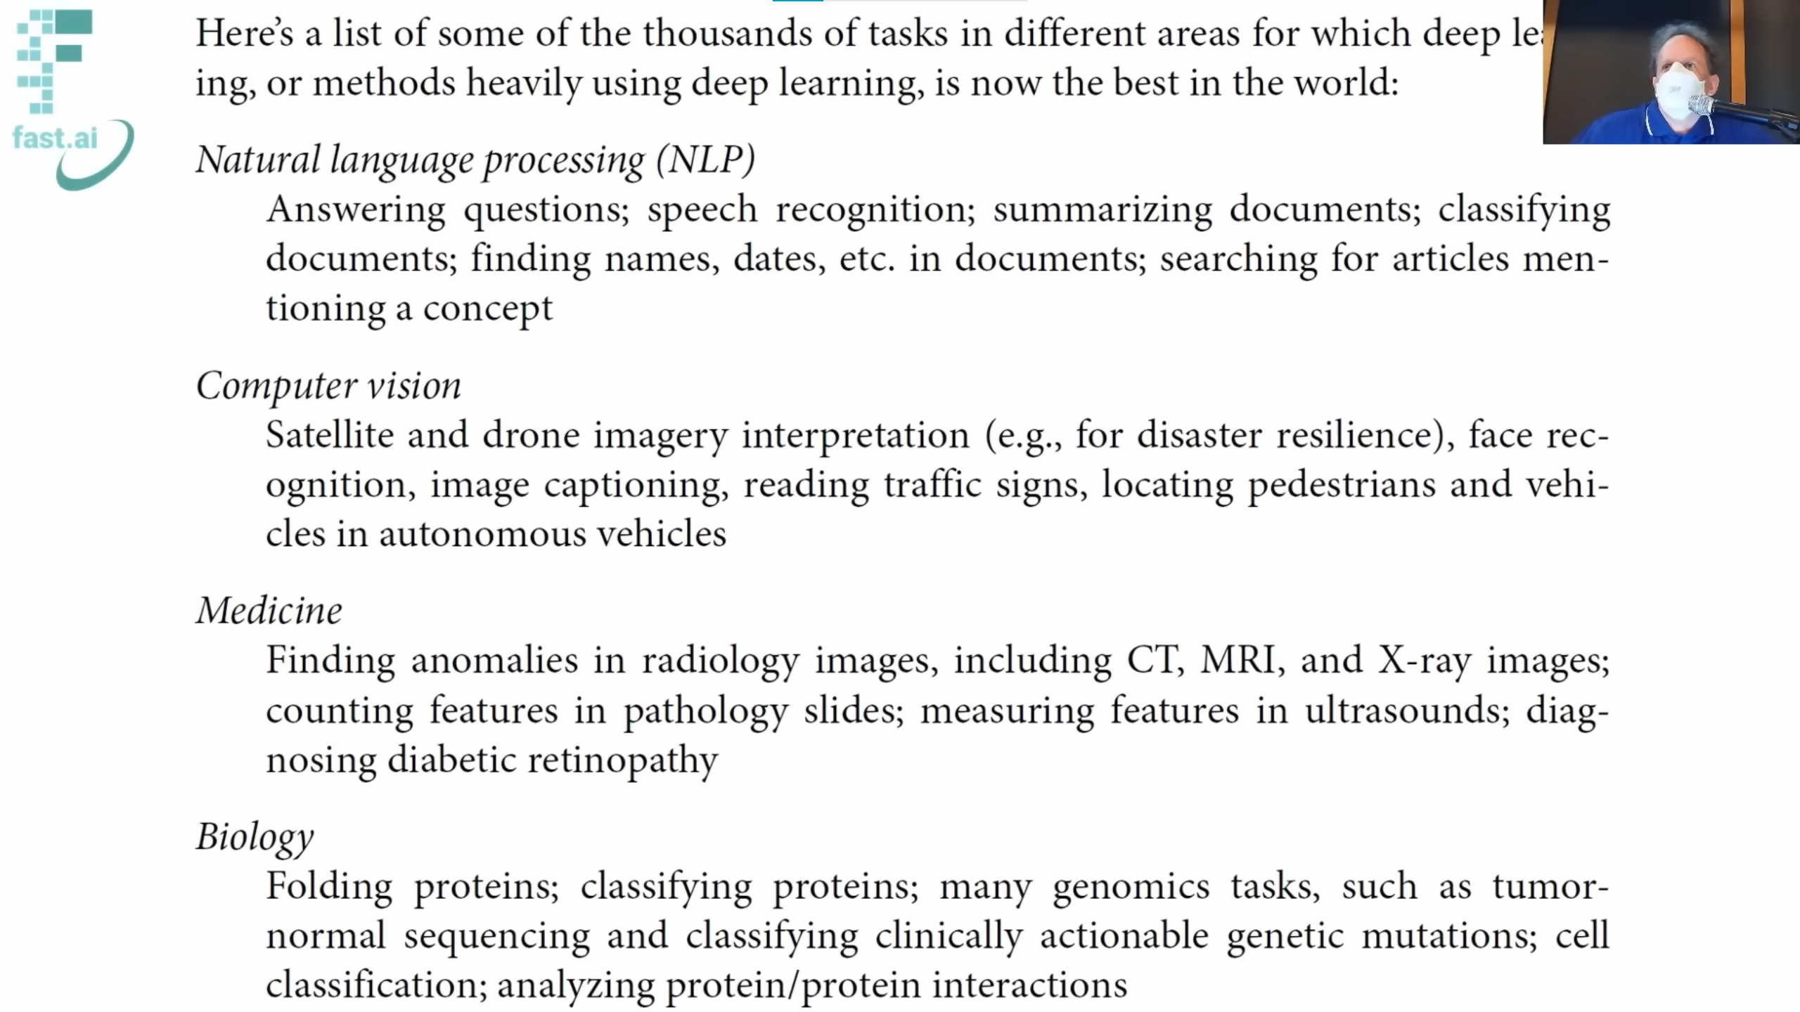

Slide 5
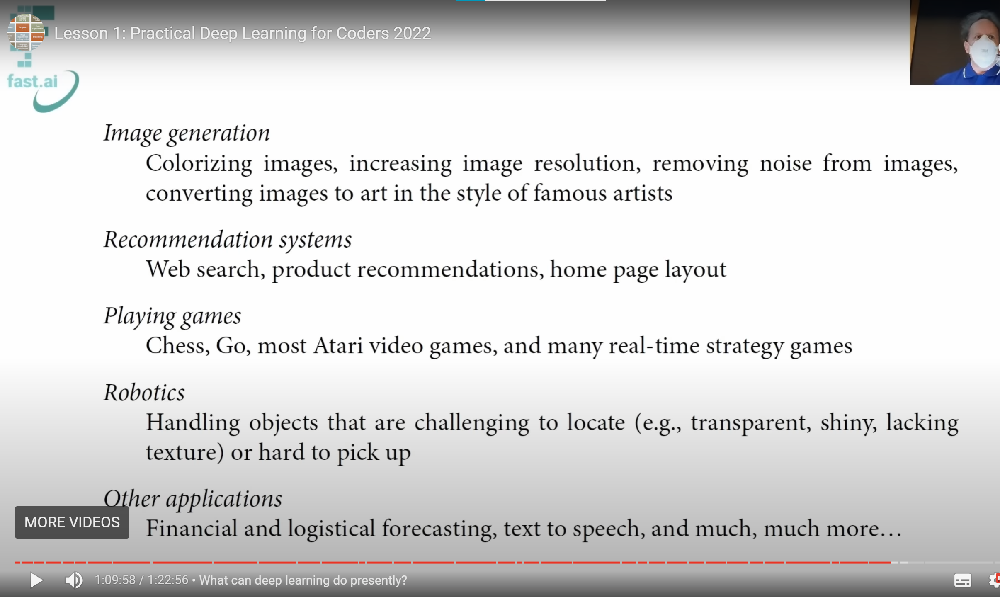

Slide 6
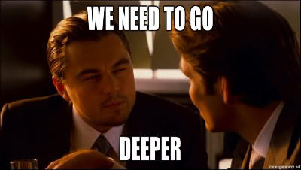
My sources of inspiration
Ukrainian Artificial Intelligence Community
Data Science UA
Interview - Done!
Yann LeCun
Yannic Kilcher [ML News] https://www.youtube.com/c/YannicKilcher
https://www.youtube.com/c/AICoffeeBreak
meetup.com before covid
Discord groups if you want to go deeper
Notes:
ML interview to Apple

Slide 7
How to learn ML DL from scratch
Practical Deep Learning from fast.ai
YouTube lectures, in 2017 Stanford CNN course was good
Coursera ML course AI For Everyone
Video about self learning from guy with no ML degree AI Epiphany
Deep Learning book Ian Goodfellow
My personal impression – don’t use untrusted sources
Make a plan, stick to it, reward yourself
Notes:
Maybe Kaggle recommendation, etc.

Slide 8
More useful recourses
Behavioral interview preparation YouTube channel

Slide 9
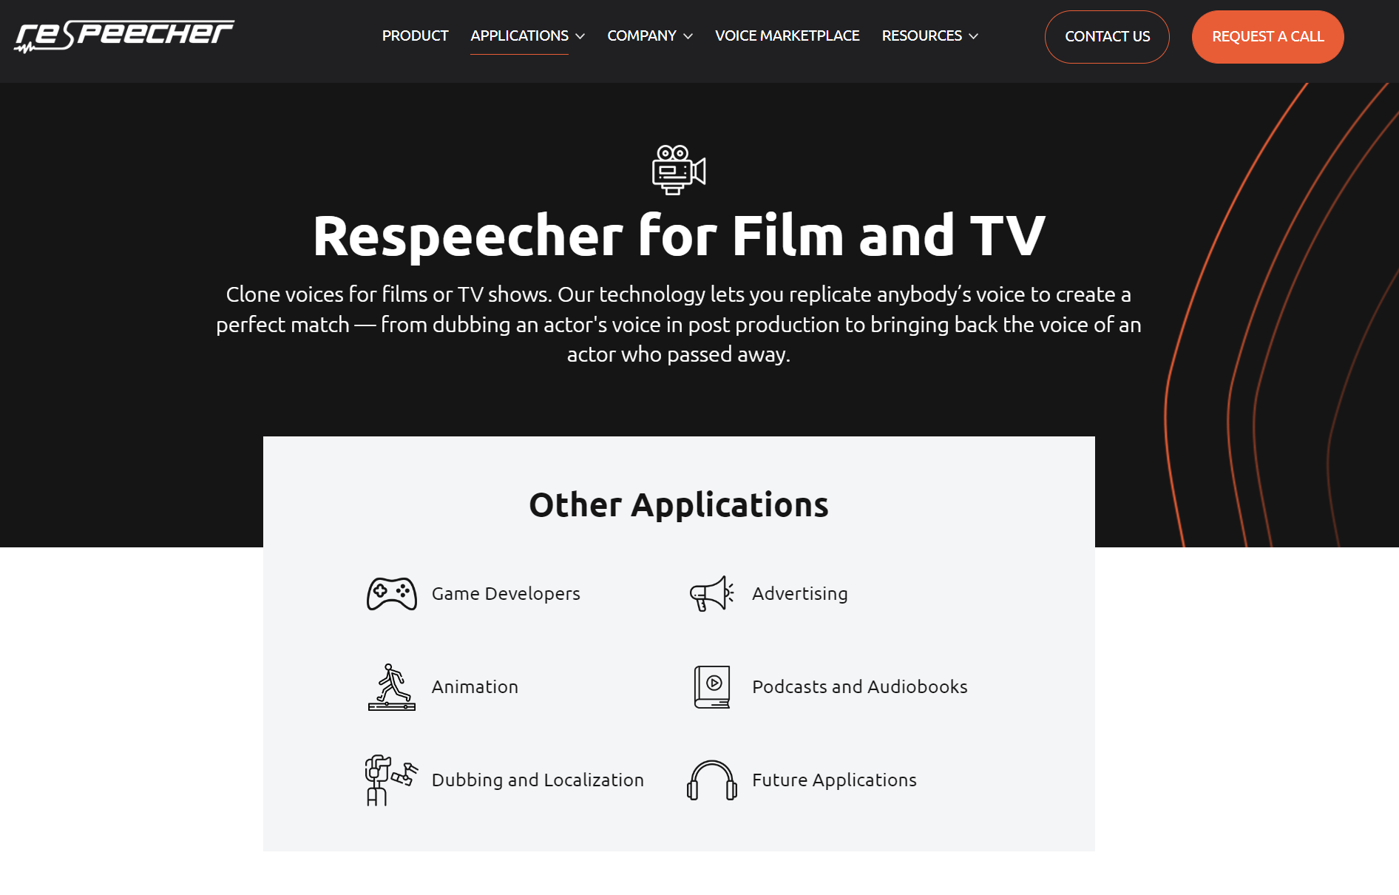
Examples: Mandalorian voice dubbing

Slide 10
Final thoughts
Connect with people and ask what you need, many people are willing to share their knowledge as well as you willing to learn.

Slide 11

#midjourney generated images on twitter

